Slide 1
Implementation of a Configurable Neural Processing Unit with Input & Weight Stationary data flows
Institute of Computer Engineering- Chair of Adaptive Dynamic Systems
Research Project - Final Presentation
Rehan Karthik Chandralal
Matrikel No: 5127834 MS Nano-electronic Systems TU Dresden, Germany
Supervised by
Mr Dr.-Ing. Ahmed Kamaledin Atef
June 26 2024

Slide 2



Overview
Motivation
Task Description
State of the Art Examples
Architecture Design of NPU
AXI Interface
Buffers
Data Pre-processing Unit
Interconnect
PE Array
Pooling Unit
Control Unit
Results & Evaluation
Future Scope
Conclusion
References

Slide 3
Motivation

Slide 4
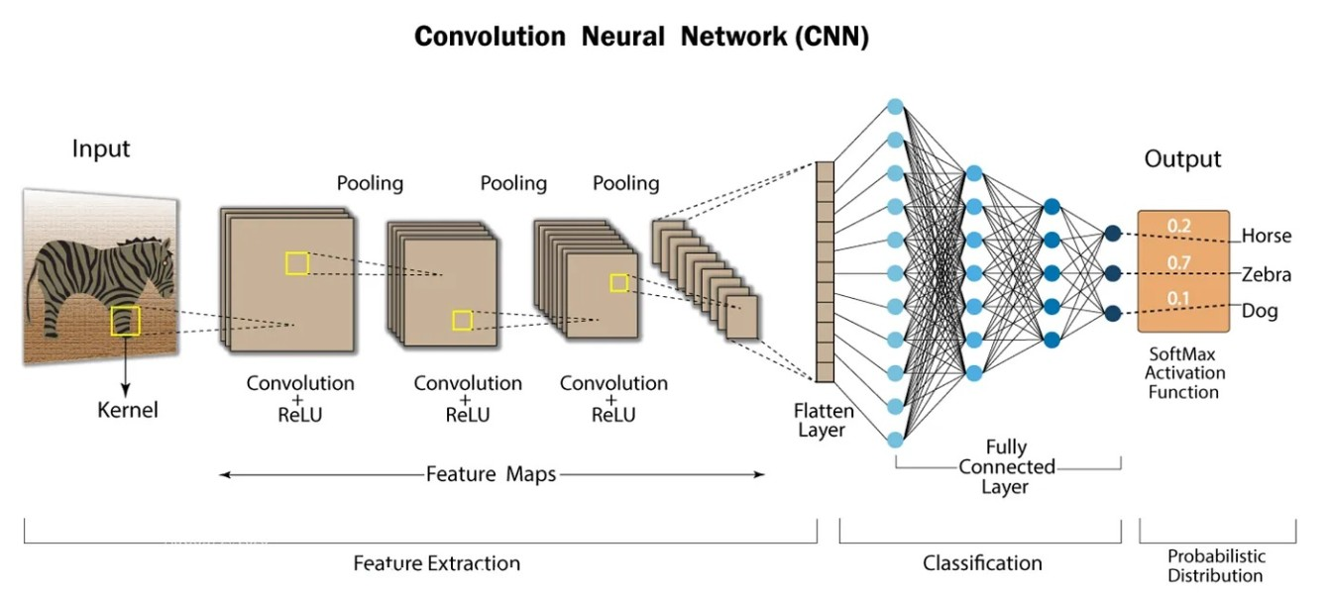
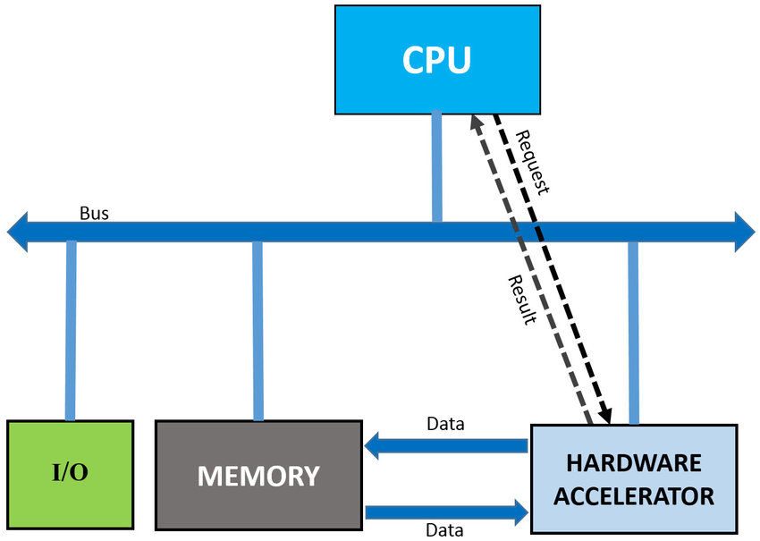
Motivation Neural Processing Unit (NPU)
Neural Processing Unit (NPU) is a specialized hardware accelerator that provides:
Optimized output for training & inference tasks of convolutional neural networks
Significant performance improvements from offloading of neural network computations from the CPU
Fig. 1. Convolutional Neural Network [1]
Fig. 2. Offloading of tasks from CPU to NPU [2]

Slide 5
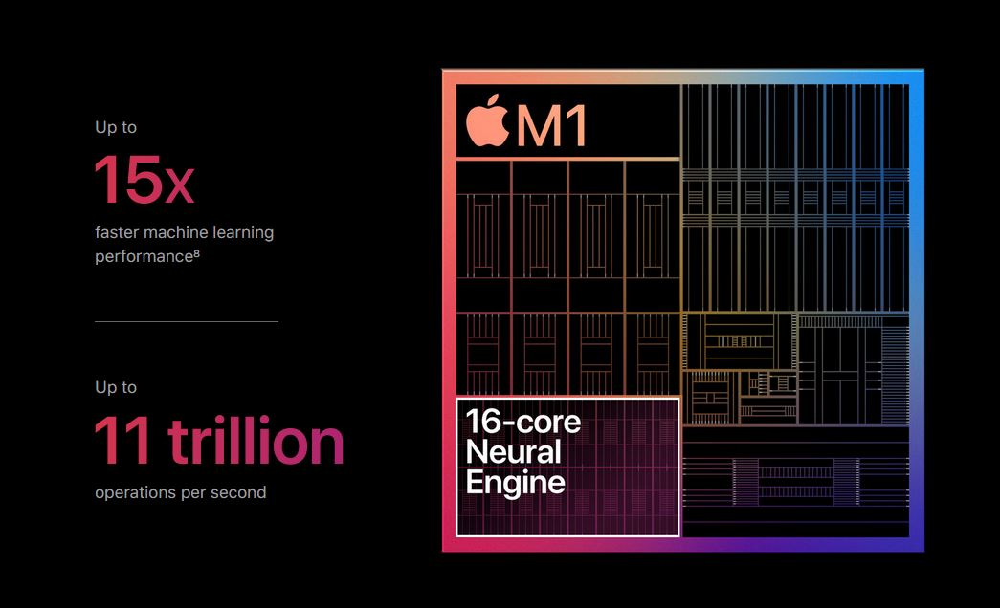
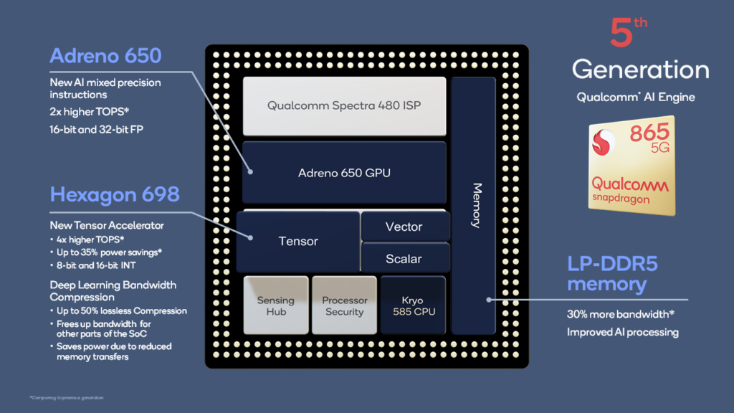
Motivation Examples of NPU
Apple Neural Engine
present in iPhones, iPads & Macs
used for image and speech recognition, natural language processing
Qualcomm Hexagon DSP
present in Snapdragon processors like 855, 865 & 888
used for accelerating AI tasks related to camera, voice assistants, and gaming.
Fig. 3. Apple M1 chip with Neural Engine [3]
Fig. 4. Qualcomm 865 with Hexagon 698 [4]

Slide 6
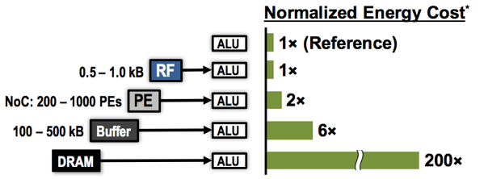
Motivation Dataflow Techniques
Data movement between several parts of the architecture can consume a large amount of power
Dataflow techniques exploit data reuse to optimize power consumption
Examples:
Weight Stationary
Input Stationary
Output Stationary
Row Stationary
Fig. 5. Comparison of energy cost of dataflow vs computation [5]

Slide 7
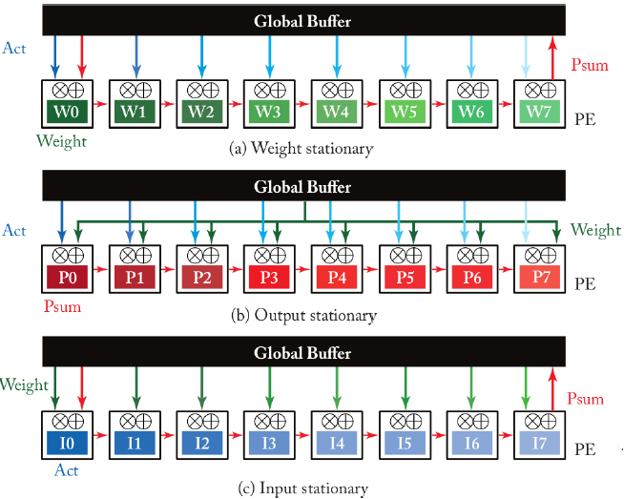
Motivation Weight Stationary Dataflow
In weight stationary data-flow, the same weight is broadcasted to all MAC Units
Data Reuse by weights being stationary across several batches of data
Use Case: Image recognition tasks using CNNs [Eyeriss] [6]
Fig. 6. Weight Stationary Dataflow [10]

Slide 8
Motivation Weight Stationary Dataflow
IA.1 W1
IA.2 W2
IA.3 W3
Batch A
MAC1
MAC2
MAC3
SA.3
SA.1
SA.2
IB.1
IB.2
IB.3
Batch B
W1
W2
W3
MAC1
MAC2
MAC3
SB.3
SB.1
SB.2

Slide 9
Motivation Input Stationary Dataflow
In input stationary data-flow, the same input is broadcasted to all MAC Units
Data Reuse by inputs being stationary across several batches of data
Use Case: Video processing of multiple frames [Diannao] [7]
Fig. 7. Input Stationary Dataflow [10]

Slide 10
Motivation Input Stationary Dataflow
I1 WB.1
I2 WB.2
I3 WB.3
Batch A
MAC1
MAC2
MAC3
SA.3
SA.1
SA.2
WB.1
WB.2
WB.3
Batch B
I1
I2
I3
MAC1
MAC2
MAC3
SB.3
SB.1
SB.2

Slide 11
Task Description

Slide 12

Task Description
Create a systolic array architecture for Multiply-Accumulate (MAC) operations
Design a flexible interconnect to support both weight and input stationary dataflows
Implement a control unit to orchestrate data transfers based on the chosen dataflow
Evaluate the developed NPU in terms of execution time, resource utilization and power consumption for the two types of dataflow models

Slide 13
State of the Art Examples

Slide 14
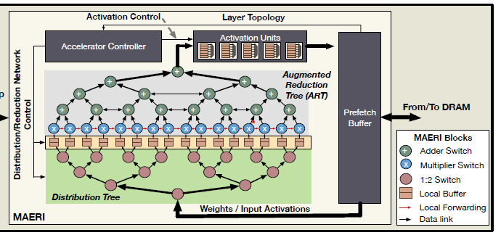
State of the Art Examples
MAERI: Enabling Flexible Dataflow Mapping over DNN Accelerators via Reconfigurable Interconnects
MAERI uses tiny switches to adjust how data flows between processing elements
Unused connections are avoided leading to significantly higher resource utilization and potentially better performance compared to rigid architectures
Fig. 8. MAERI Architecture [8]

Slide 15
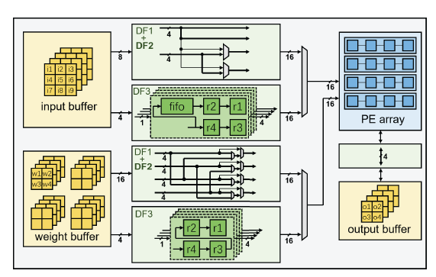
State of the Art Examples
2. Flexible Dataflow CNN Accelerator on FPGA
This design uses reconfigurable logic to handle diverse layers and dataflows
Resource utilization is improved by dynamically adjusting its processing pipeline and avoiding unnecessary computations, potentially achieving higher efficiency than fixed accelerators
Fig. 9. Flexible Dataflow CNN Accelerator on FPGA [9]

Slide 16
Architecture Design of NPU

Slide 17
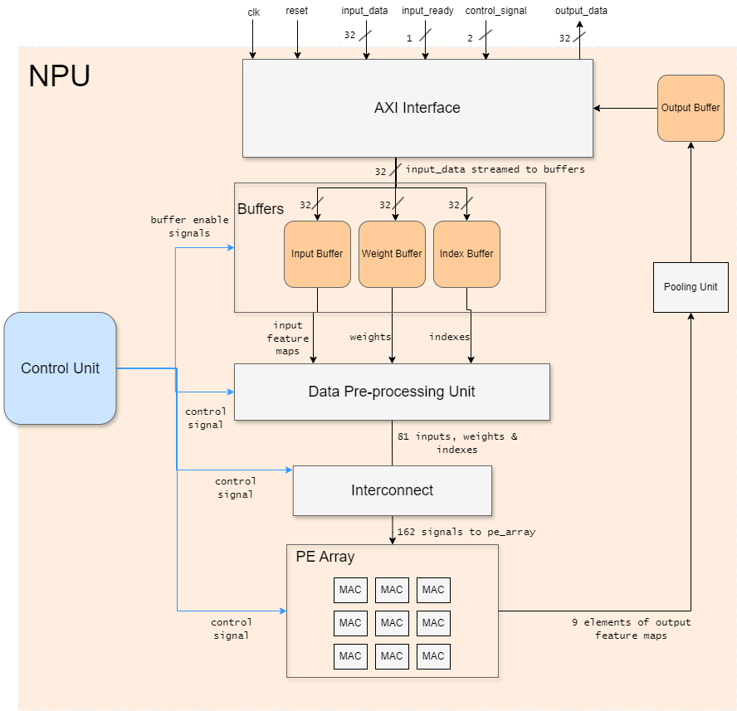
Overview of NPU Architecture
AXI Interface
Buffers
Data Pre-processing Unit
Interconnect
PE Array
Pooling Unit
Control Unit
Fig. 10. NPU Architecture

Slide 18
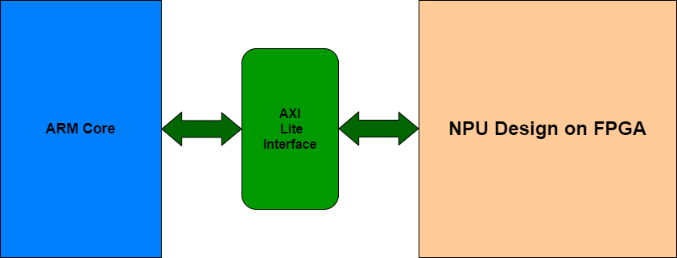
AXI Interface
AXI Lite Interface serves two primary functions:
It receives a data packet per clock cycle from the Core and routes it to the designated buffers (input, weight, or index) in the NPU
After processing, the system streams elements of the output feature map from the output buffer back to the user
Fig. 11. AXI Interface

Slide 19
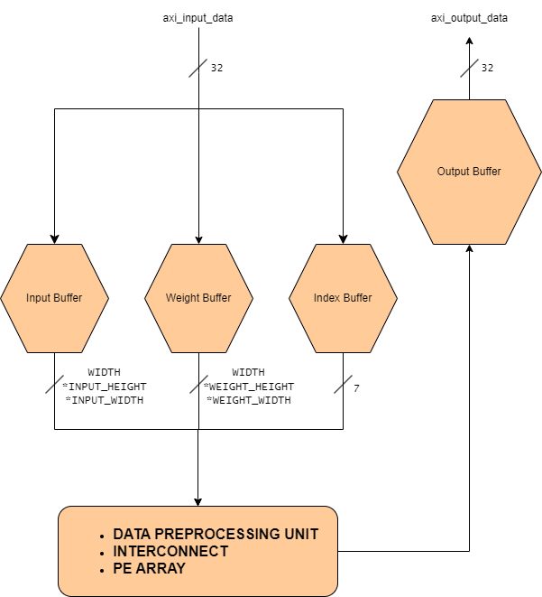
Buffers
Buffers serve as temporary storage units that facilitate efficient data flow management within the NPU
Input Buffer
Weight Buffer
Index Buffer
Input Buffer
Weight Buffer
Index Buffer
INPUT DATA
OUTPUT DATA
4. Output Buffer
Fig. 12. Overview of all Buffers

Slide 20
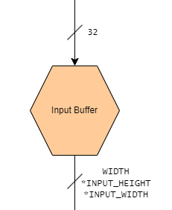
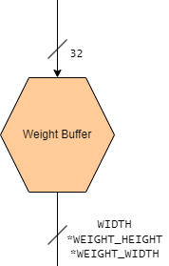
Buffers Types of buffers
1. Input Buffer
The input feature map represents the raw data or the input image supplied to the NPU
Elements of the input feature maps are stored in the input buffer
2. Weight Buffer
Weights are the adjustable parameters that are fine-tuned during training to identify important features within the input data
Elements of the weights matrix is stored in the weight buffer
Fig. 12. Overview of all Buffers

Slide 21
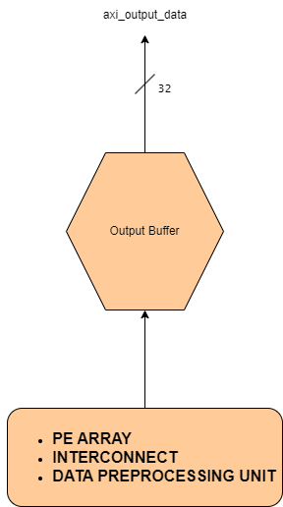
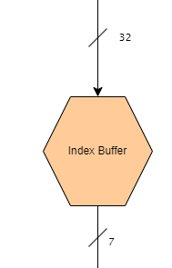
Buffers Types of buffers
3. Index Buffer
The index buffer allows users to assign input data to specific MAC units
7 bits are used to represent 81 possible MAC units
4. Output Buffer
The output buffer accepts data from the PE array and transfers it to the user via AXI interface
Stores elements of the final output feature map
Fig. 12. Overview of all Buffers

Slide 22
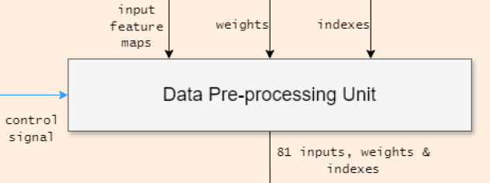
Data Pre-processing Unit
The input data needs to be processed for the convolution operation
To reduce complexity of PE Array, a separate module named Data Pre-processing unit is used
It receives inputs from the Buffers and supplies processed data to the Interconnect module
Fig. 13. Data Pre-processing Unit

Slide 23
Data Pre-processing Unit Functions
The Data Pre-processing Unit performs 3 main functions:
Modifying Input Matrix for Zero padding and different Stride lengths
Mapping Convolution onto Toeplitz matrix
Batch division
Fig. 13. Data Pre-processing Unit

Slide 24
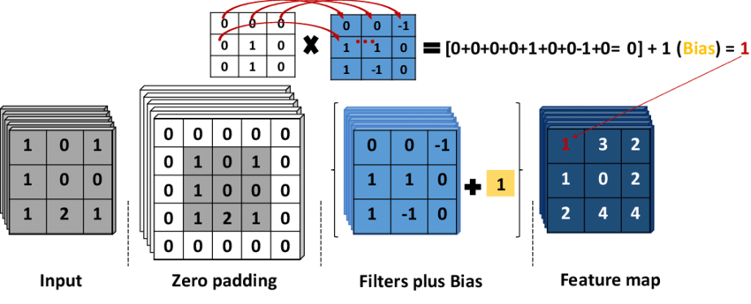
Data Pre-processing Unit Functions-Modifying Input Matrix for Zero padding and different Stride lengths
Dimensions of the input data matrix are adjusted to accommodate
Zero-padding (increase in dimensions)
Varying stride lengths (decrease in dimensions)
Zero Padding
extra rows and columns of zeros added around the borders of the input data matrix
Output feature map has same size as input feature map
Fig. 14. Zero Padding [11]

Slide 25
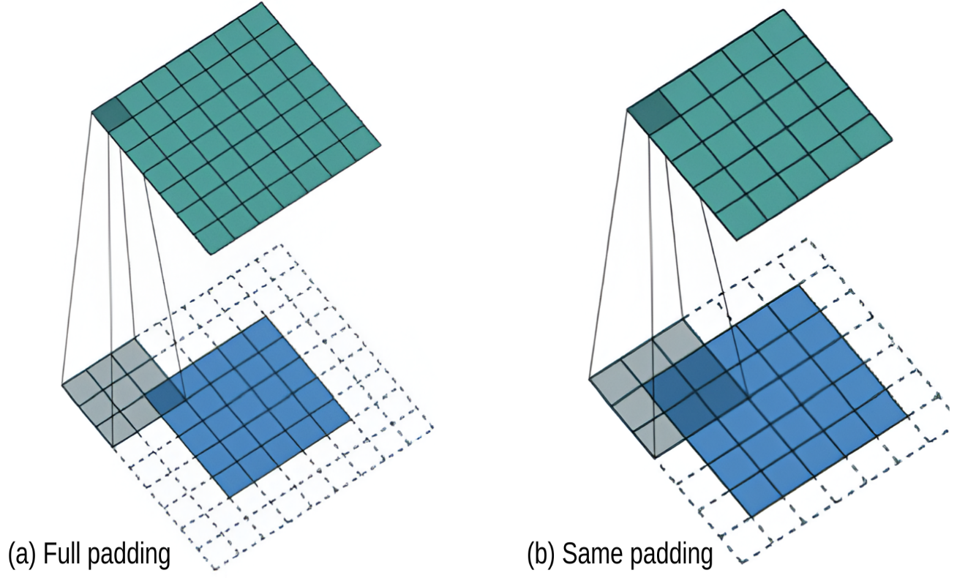
Data Pre-processing Unit Functions-Modifying Input Matrix for Zero padding and different Stride lengths
Full Padding
all pixels are visited equal number of times by the filter
output feature map with increased spatial dimension
Same Padding
output feature map has the same spatial dimensions as the input
Fig. 15. Full and Same Padding [12]

Slide 26
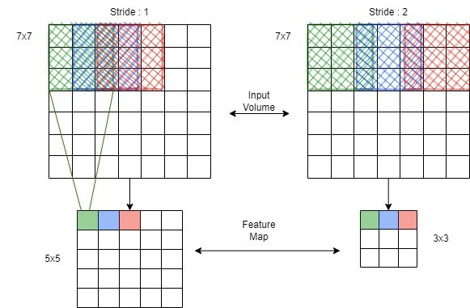
Data Pre-processing Unit Functions-Modifying Input Matrix for Zero padding and different Stride lengths
Stride
increment size used when sliding a kernel across the input data
Larger stride leads to smaller output feature maps
Fig. 16. Stride = 1 and Stride = 2 [13]

Slide 27
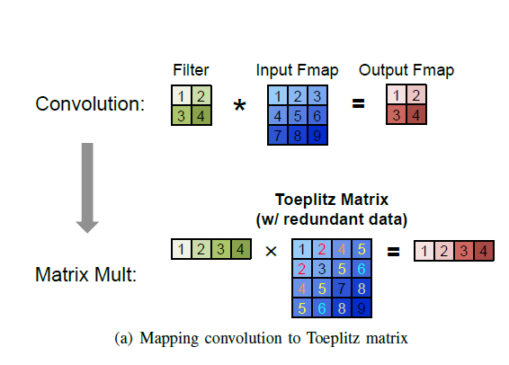
Data Pre-processing Unit Functions-Mapping Convolution onto Toeplitz Matrix
Convolution operations can be expressed as simple matrix multiplications using the Toeplitz Matrix
Size of Toeplitz Matrix is given by :
Ntoe = (Hin − 2) * (Win − 2) * K
Parameter | Description
Ntoe | Total no. of elements in the Toeplitz matrix
Hin | Input Feature Map Height
Win | Input Feature Map Width
K | Kernel Size
Fig. 17. Convolution using Toeplitz Matrix [14]
Table. 1. Toeplitz Matrix Parameters

Slide 28
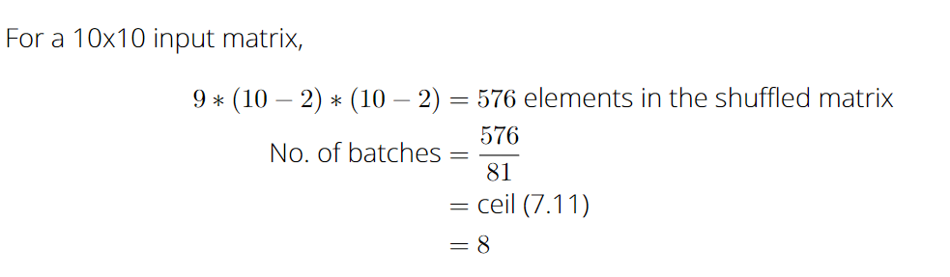
Data Pre-processing Unit Functions-Batch Division
Since the PE array has a size of 9x9, it can only process 81 inputs and weights simultaneously
For input feature map sizes larger than 9*9, it becomes necessary to divide the data into batches

Slide 29
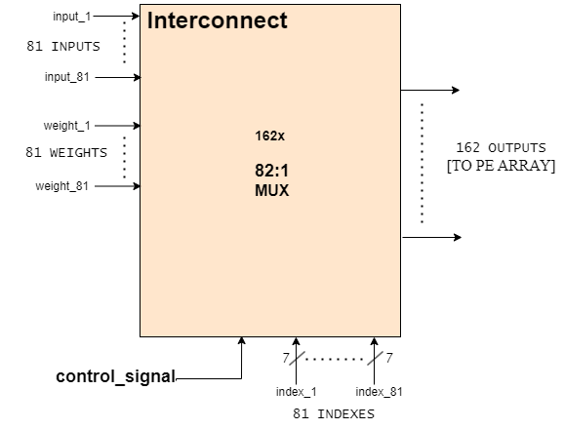
Interconnect
Array of multiplexers responsible for implementing weight & input stationary dataflow
Out of 162 multiplexers,
81 multiplexers channel input values to the PE array
The other 81 multiplexers channel weight values to the PE array
Fig. 18. Interconnect Module

Slide 30
Interconnect
A control signal determines whether the multiplexer in the interconnect selects data from the input matrix or the weight matrix
This data is fed into a designated MAC unit in the PE array
Control Signal | Mode
00 | Weight Stationary with Unicast
01 | Weight Stationary with Multicast
10 | Input Stationary with Unicast
11 | Input Stationary with Multicast
Fig. 18. Interconnect Module

Slide 31
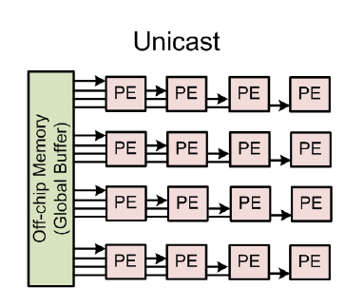
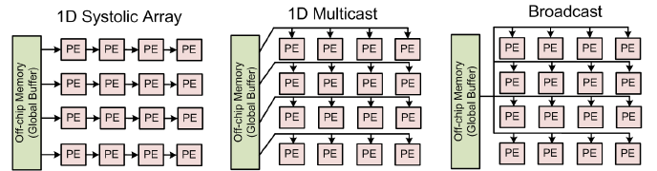
Interconnect
Unicast :- One specific signal is sent to one specific PE
Multicast :- One signal is sent to one row of PE‘s
Broadcast :- One signal is sent to all 81 PE‘s
Fig. 19. Types of Communication Modes [14]

Slide 32
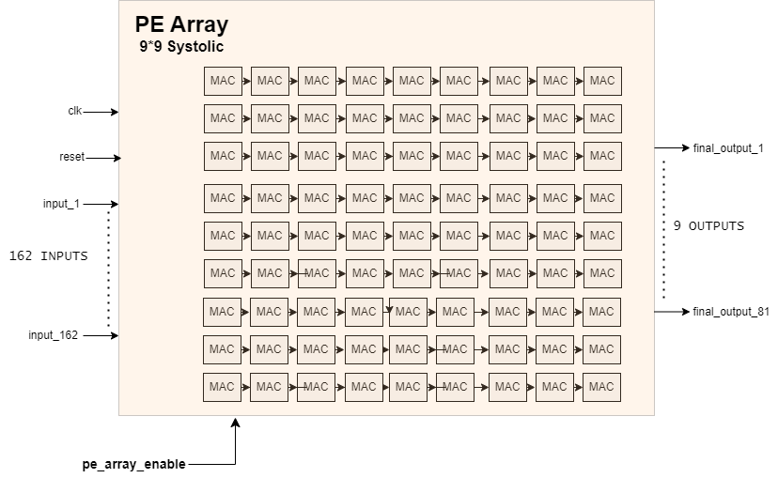
PE Array
It receives inputs (single channel) and weights corresponding to the selected dataflow from the interconnect module and performs convolution
Comprises of 81 MAC units arranged in 9*9 format
As the Kernel size is 3*3, 9 elements of the output feature map are produced for one batch of inputs and weights
Fig. 20. PE Array (systolic)

Slide 33
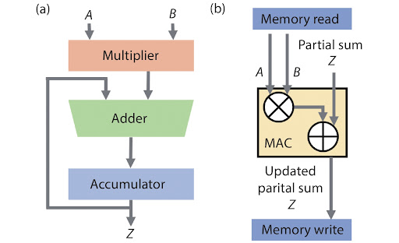
PE Array MAC unit
As data streams through the 9 MAC units present in a row of the PE array, one element of the Output feature map is formed
The MAC unit is implemented with the usage of DSP slices on the FPGA
Fig. 21. MAC Unit [15]

Slide 34
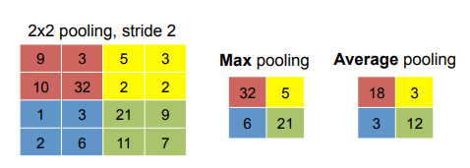
Pooling Unit
Pooling Operation reduces size of feature maps in order to reduce computational complexity and memory requirements
Max Pooling selects the maximum value within a predefined window of 2*2
Average Pooling computes the average value in the same window of 2*2
Fig. 22. Max & Average Pooling [16]

Slide 35
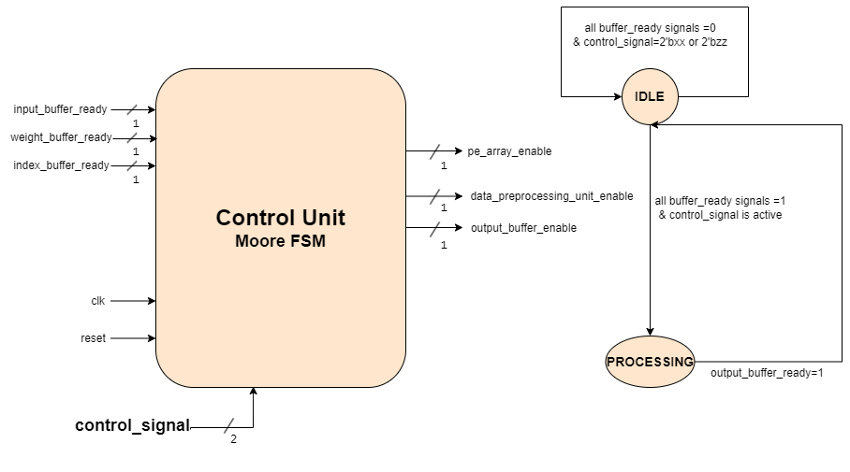
Control Unit
The Control Unit facilitates communication and synchronization between various modules
State Transition is primarily driven by
input signals such as buffer readiness
control signals from the user
Fig. 23. Control Unit

Slide 36
Results & Evaluation

Slide 37
Results & Evaluation Design Features of the NPU
Convolution Layer Parameters Parameters | Maximum Range
Kernel Size (bits*bits) | 3*3
Data Width | up to 18 bits
Input feature Map size (bits*bits) | from 5*5 to 256*256 (non-square matrix also supported)
No of dataflows | 2 (Input and Weight stationary)
No of communication modes | 3 (Broadcast, Multicast and Unicast)
Stride | 1,2,3,4
Pooling | 2 types (Max and average pooling)
Padding | 2 types (Full and same padding)
Table. 2. Design Features

Slide 38
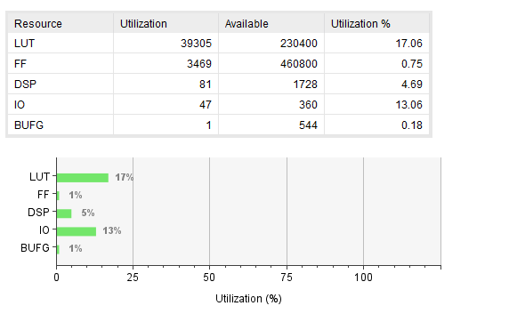
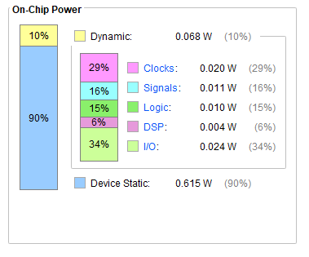
Results & Evaluation Clock Info, Resource Utilization & Power Consumption
Clock Period (ns) | Frequency (MHz)
7.1 | 140
Fig. 25. Resource Utilization
Fig. 24. Power Consumption

Slide 39
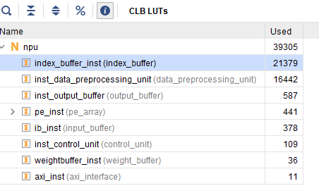
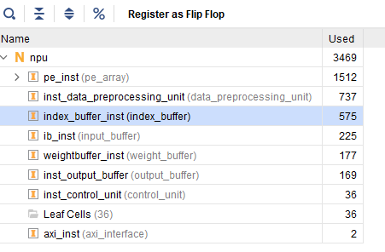
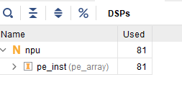
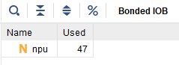
Results & Evaluation Detailed Resource Utilization
Fig. 26. LUT Utilization
Fig. 27. Flip Flop Utilization
Fig. 28. DSP & IO Utilization

Slide 40
Results & Evaluation Simulation
Testcase 1 = Input Stationary with Zero padding
A Simulation was performed on an Input feature map of size =7*7 with control signal = 10 ( Input stationary with Unicast)
Testcase Parameters P | Value
DATA WIDTH | 4
INPUT_WIDTH | 7
INPUT_HEIGHT | 7
KERNEL_SIZE | 3
WEIGHT_HEIGHT | 21
WEIGHT_WIDTH | 21
STRIDE | 1
PADDING | 1
Table. 3. Parameters for Testcase 1

Slide 41
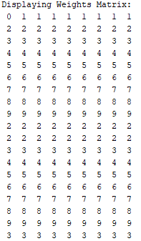
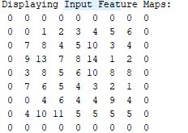
Results & Evaluation Simulation
Fig. 29. Input Feature Maps & Weights for Testcase 1

Slide 42
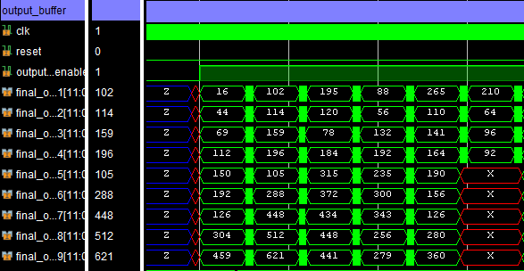
Results & Evaluation Simulation
Fig. 30. Outputs for Testcase 1

Slide 43
Results & Evaluation Simulation
Testcase 2 = Weight Stationary with Stride = 2
A Simulation was performed on an Input feature map of size =32*32 with control signal = 00 ( Weight stationary with Unicast)
Testcase Parameters P | Value
DATA WIDTH | 8
INPUT_WIDTH | 32
INPUT_HEIGHT | 32
KERNEL_SIZE | 3
WEIGHT_HEIGHT | 3
WEIGHT_WIDTH | 3
STRIDE | 2
PADDING | 0
Table. 4. Parameters for Testcase 2

Slide 44
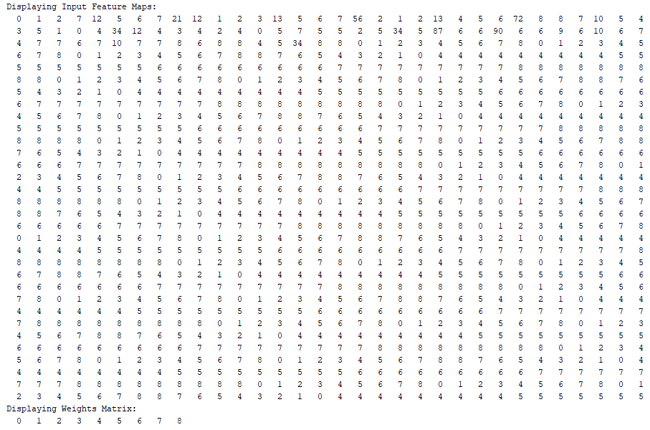
Results & Evaluation Simulation
Fig. 31. Input Feature Maps & Weights for Testcase 2

Slide 45
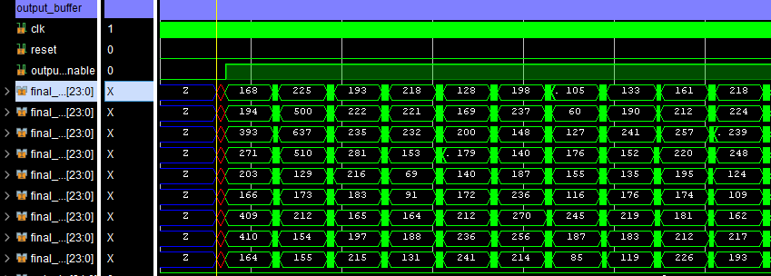
Results & Evaluation Simulation
Fig. 32. Outputs for Testcase 2

Slide 46
Future Scope

Slide 47
Future Scope
Expanding Dataflow Exploration:
Investigate output- and row-stationary dataflows to further optimize memory access and resource utilization within the NPU
Advanced Interconnect Design:
Explore the feasibility of incorporating network-on-chip (NoC) principles within the NPU for more scalable communication between PEs, especially for larger array sizes

Slide 48
Conclusion

Slide 49
Conclusion
This versatile NPU architecture optimizes dataflows leading to significant performance gains and lower power consumption.
The configurable interconnect and diverse features (stride, padding, pooling) ensure the NPU can handle a wide range of CNN architectures and applications.
The design leverages DSP slices for efficient MAC operations, maximizing resource utilization on the FPGA platform.
Performance analysis across various convolution layer parameters validates the effectiveness of the NPU design.

Slide 50
References

Slide 51
References
Convolutional Neural Network https://nafizshahriar.medium.com/what-is-convolutional-neural-network-cnn-deep-learning-b3921bdd82d5
Ravi, Murali & Sewa, Angu & G., Shashidhar & Sanagapati, Siva. (2019). FPGA as a Hardware Accelerator for Computation Intensive Maximum Likelihood Expectation Maximization Medical Image Reconstruction Algorithm. IEEE Access. PP. 1-1. 10.1109/ACCESS.2019.2932647.
Apple M1 chip https://www.techinsights.com/blog/analysis-apple-m1-happening-and-thermal-imaging
Qualcomm 865 chip with Hexagon DSP https://www.edge-ai-vision.com/2021/04/tvm-open-source-compiler-now-includes-initial-support-for-qualcomm-hexagon-dsp/
Comparison of energy cost of Dataflow vs Computation https://allenlu2007.wordpress.com/2019/05/12Architecture-and-energy-efficiency/
Yu-hsin Chen, T. Krishna, V. Sze. "Eyeriss: An Energy-Efficient Reconfigurable Accelerator for Deep Convolutional Neural Networks." In Proceedings of the 43rd International Symposium on Computer Architecture (ISCA '16). IEEE Press, Article 74, June 2016
"DianNao: A Sparse Neural Network Accelerator" by Jungwook Choi et al.
Hyoukjun Kwon, Ananda Samajdar, and Tushar Krishna. MAERI: Enabling Flexible Dataflow Mapping over DNN Accelerators via Reconfigurable Interconnects. 2018.
Haoran Li et al. A Flexible Dataflow CNN Accelerator on FPGA. 2023.
Y.-H. Chen, J. Emer, and V. Sze. Eyeriss: A Spatial Architecture for Energy-Efficient Dataflow for Convolutional Neural Networks. 2016
Serveh Kamrava, Pejman Tahmasebi, and Muhammad Sahimi. Linking Morphology of Porous Media to Their Macroscopic Permeability by Deep Learning. 2019. DOI: 10.1007/s11242-019-01352-5

Slide 52
References
Avinash Kumar, Sobhangi Sarkar, and Chittaranjan Pradhan. Malaria Disease Detection Using CNN Technique with SGD, RMSprop and ADAM Optimizers. 2023.
Baeldung. Convolutional Neural Network Channels.
Vivienne Sze et al. Efficient Processing of Deep Neural Networks: A Tutorial and Survey. 2020. DOI: 10.1109/JSTSP.2020.3009164.
Jia Chen et al. Multiply accumulate operations in memristor crossbar arrays for analog computing. 2021. DOI: 10.1088/1674-4926/42/1/013104.

Slide 53
Thank you for your time and patience

